Slide 1
Smart SDLC
Intelligent Software Delivery for the Enterprise
DEV UP 2026

Slide 2
Building the Future of Software Delivery
Where Product Engineering meets AI-Driven Intelligence
Product Engineering
AI & Machine Learning
System design, architecture governance, delivery frameworks
Foundation models, RAG, multi-agent orchestration
Platform & DevOps
Data Engineering
CI/CD, observability, infrastructure as code
Graph databases, vector stores, knowledge management

Slide 3
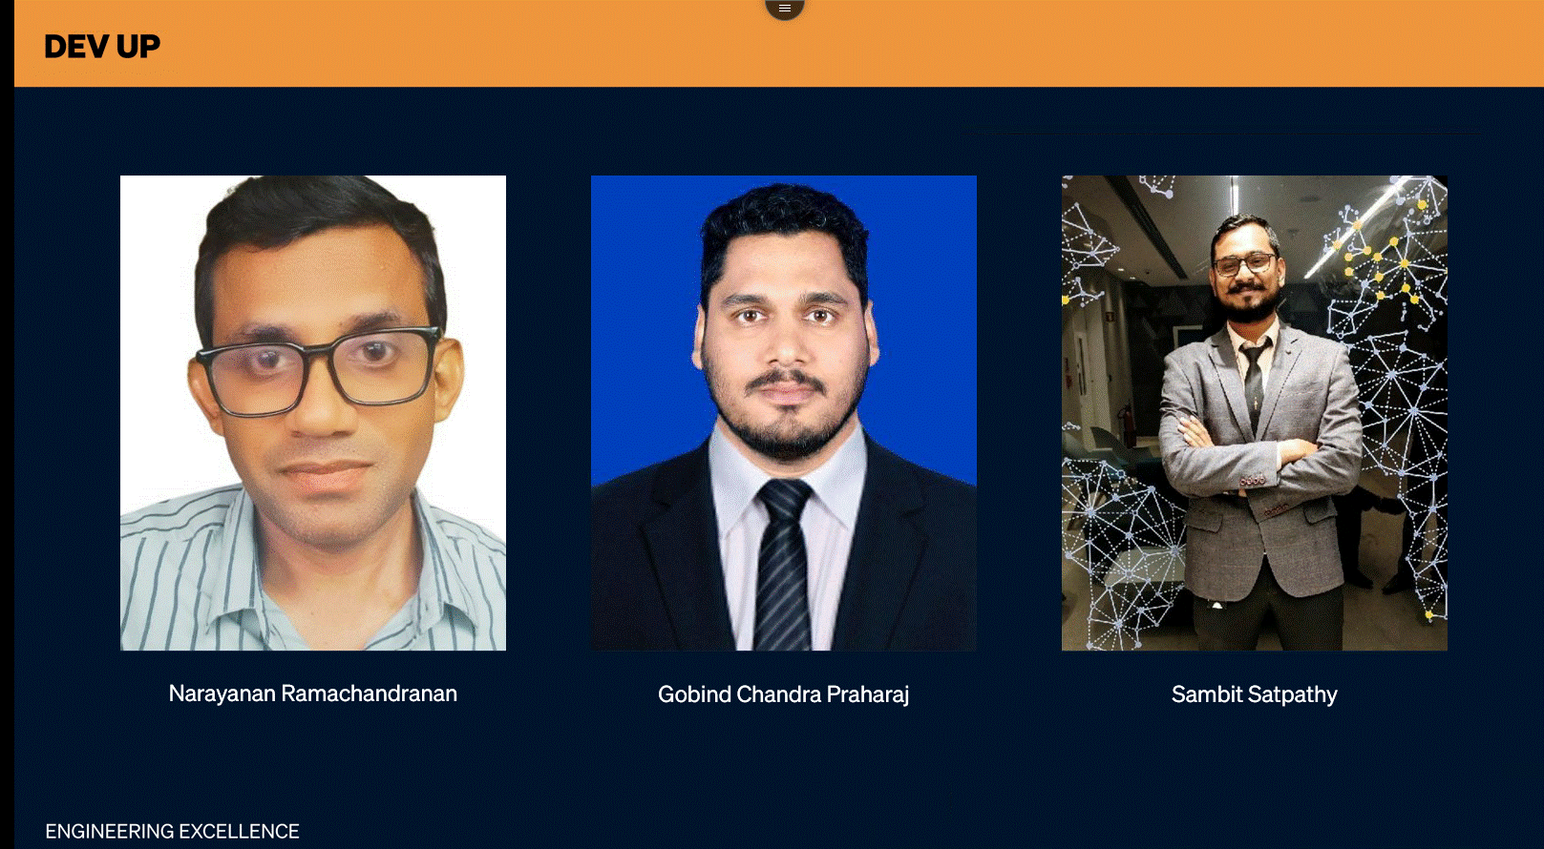
DEV UP

Slide 4
DEV UP
The Path Forward
A 35-minute journey through the future of software delivery
01
The Reality of Scale
0:00 – 14:00
Why coordination costs more than code
02
The Pivot
14:00 – 17:30
From execution problem to memory problem
03
Watch It Work
17:30 – 24:00
Smart SDLC in action — live scenario
04
Every Role, Transformed
24:00 – 29:00
Product, Leadership, Architecture, Dev, Ops
05
Engine, Roadmap, Payoff
29:00 – 35:00
Architecture, evolution, and ROI
ENGINEERING EXCELLENCE

Slide 5

DEV UP
The Scale Reality
Smart SDLC
The friction that emerges when complexity outpaces human coordination — we call it the Scale Tax.
The Paradox
More people, more process → more friction, not less
The Context Gap
Information exists but nobody can find it in time
The Coordination Trap
Humans become routers between disconnected systems
"Every team is scaling. Very few are scaling coherently."
ENGINEERING EXCELLENCE

Slide 6
DEV UP
The Paradox

Slide 7

DEV UP

Slide 8
DEV UP
The Context Gap

Slide 9
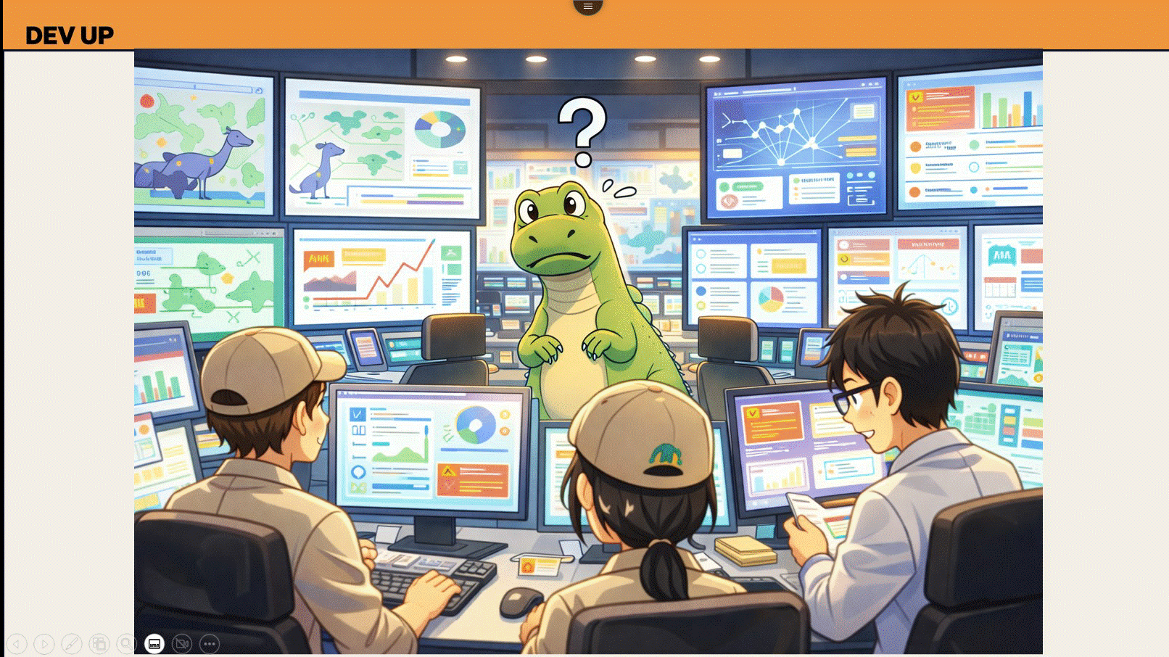
DEV UP

Slide 10
DEV UP
The Coordination Trap

Slide 11
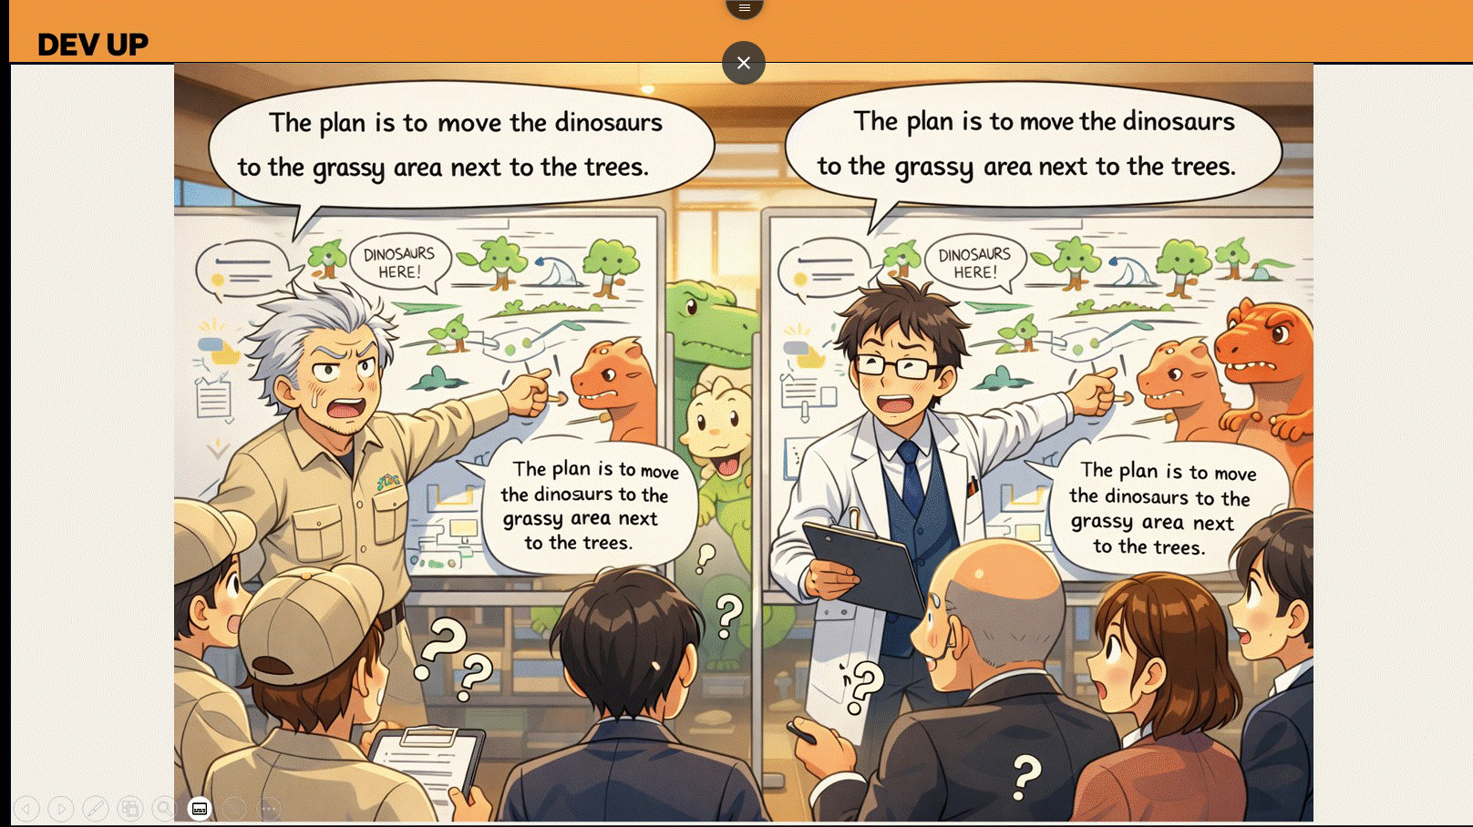
DEV UP

Slide 12
DEV UP
The Three Crises of Scale
Why traditional approaches break at enterprise scale
The Paradox
The Context Gap
The Coordination Trap
More People ≠ More Speed. Adding talent increases interaction paths exponentially. Coordination costs overtake execution costs. The tax of alignment becomes the dominant expense.
Information Exists But Can't Be Found. Every tool captures fragments. None connect them. Developers spend 60% of time searching, not building. Knowledge lives in people's heads.
Humans as Routers. Senior engineers become walking wikis instead of innovators. Every meeting is a context-sync ritual. Talent is tragically misallocated to routing memory.
✓ n people → n(n-1)/2 interactions
✓ Tribal knowledge = single point of failure
✓ 2 days to build, 2 weeks to align
✓ Process becomes the bottleneck
✓ Context drift compounds daily
✓ Routing memory ≠ engineering
ENGINEERING EXCELLENCE

Slide 13
DEV UP
Why Tools Fail?

Slide 14
DEV UP
The Gap
The 2026 Paradox
Why Faster AI Makes Coherence Harder
The AI tools accelerating code generation don't preserve intent.
CURRENT TOOLING
FUNCTION (WHAT IT DOES)
THE MISSING LINK (WHAT IS LOST)
Jira
✓ Tracks Activity
✗ Not Intent (The 'Why' is lost)
Git
✓ Tracks Code
✗ Not Rationale (The 'Decision' is lost)
CI/CD
✓ Tracks Pipelines
✗ Not Readiness (The 'Context' is lost)
Observability
✓ Tracks Incidents
✗ Not Original Design (The 'Root' is lost)
AI Copilots & Agents
✓ Tracks Output
✗ Not Understanding (The 'Why' is lost)
NEW
"The faster you build, the faster you accumulate context debt."
The Smart SDLC Value-Add
Not a replacement for AI coding tools — the layer that makes them safe, governed, and coherent at enterprise scale.
ENGINEERING EXCELLENCE

Slide 15
DEV UP
Moment of Crisis

Slide 16

DEV UP

Slide 17
DEV UP
The Strategic Pivot
Shift Left, Connect Everything
The Core Concept
Capture Intent early → Generate Artefacts autonomously → Maintain Connectivity always.
Late Clarity
Late Alignment
Late Fixes
Is Expensive Results in heavy Rework. Design flaws found in code cost 10x more to fix.
Is Fragile Creates disconnected Silos. Teams build compatible components for incompatible goals.
Are Inevitable Accumulate as Technical Debt. Speed now becomes paralysis later.
"Delivery requires a system that remembers, so your people don't have to."
ENGINEERING EXCELLENCE

Slide 18
DEV UP
Smart SDLC

Slide 19
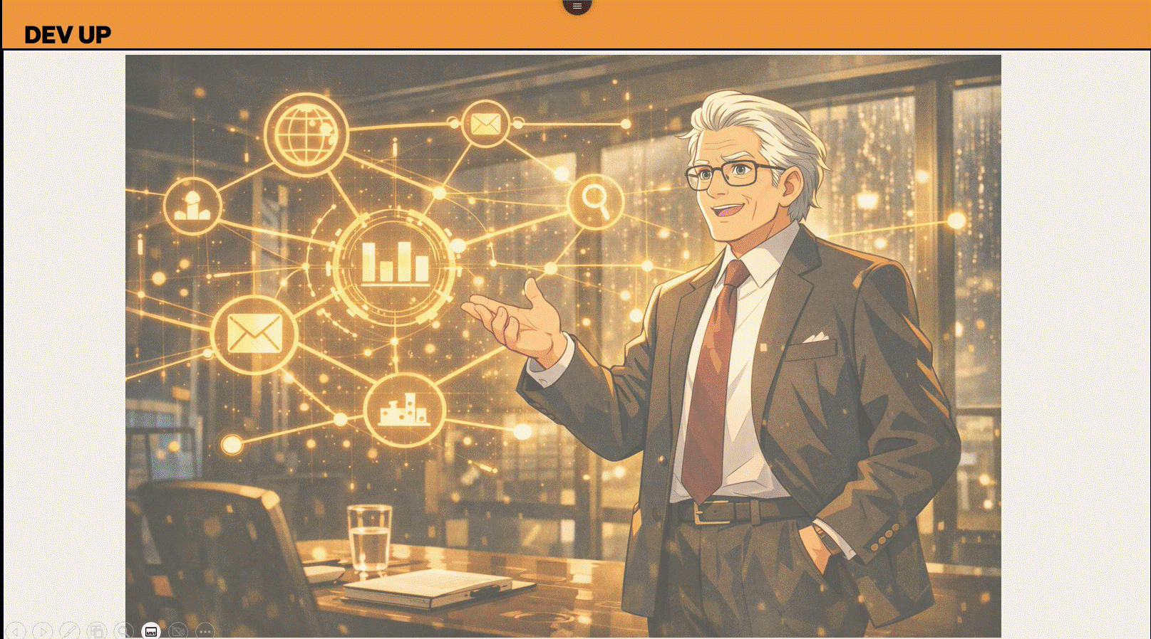
DEV UP

Slide 20
DEV UP
What Smart SDLC Is (and Isn't)
A Unified Intelligence Layer for Modern Delivery
✓ What It Is
✗ What It Is NOT
A Delivery System
Not a Replacement for Talent
A holistic framework that connects the entire lifecycle, not just a disconnected workflow tool.
It amplifies human decision-making; it does not replace the creative engineer or product owner.
vs
Shared Intelligence
Not a Tool-Chain Replacement
A role-aware layer that understands and surfaces the specific context every contributor needs.
It integrates with Jira, Git, and CI/CD. It sits above them; it doesn't displace them.
Evidence-Based Progression
Not a Governance Bottleneck
Delivery gates operate on verifiable proof (tests, metrics, artefacts), not manual status updates.
It automates compliance checks in real-time rather than adding manual review steps.
ENGINEERING EXCELLENCE

Slide 21
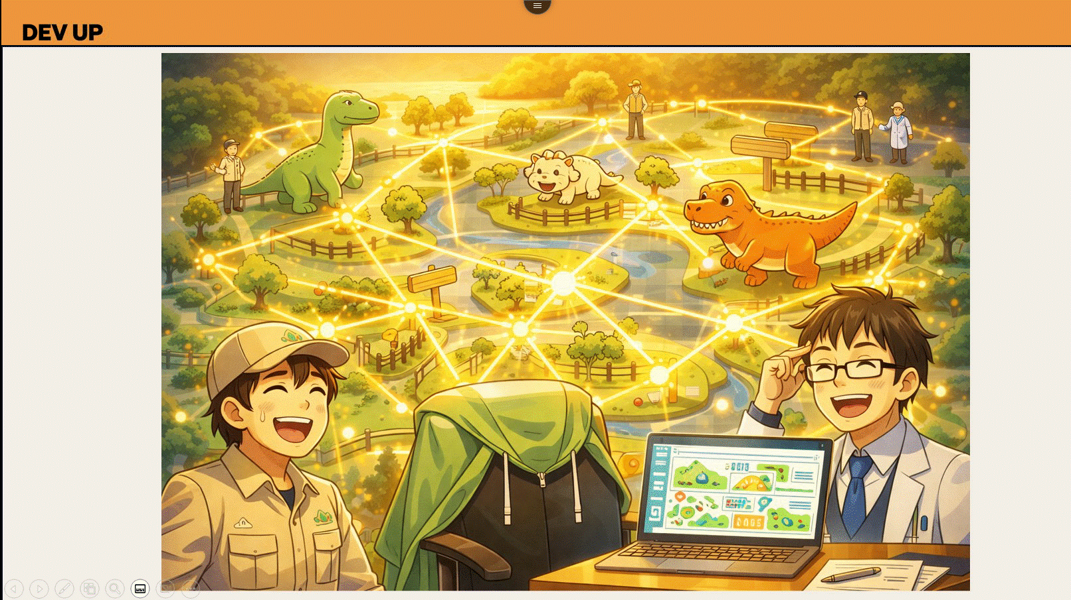
DEV UP

Slide 22
DEV UP
The Moment of Truth
Watch Smart SDLC Think
Two weeks of alignment → Under a minute
1
2
3
INTENT CAPTURED
GRAPH ACTIVATES
ARTEFACTS GENERATED
PM types: "Add multi-currency support to payments service" OR Engineer opens the Nedry module — and the system speaks.
The Delivery Graph: • Retrieves architecture • Finds regulatory constraints • Locates last 3 design decisions • Maps downstream impact Nodes light up. Connections activate. Context flows.
In seconds: ✓ Structured Requirements ✓ Architecture Recommendation ✓ Conflict Flags ✓ Test Scenarios ✓ Compliance Evidence Developer builds with clarity.
→
→
"That is not a chatbot. That is an AI system that understands your organisation."
ENGINEERING EXCELLENCE

Slide 23
DEV UP
The AI Engine
Autonomous Artefact Synthesis
AI as a Native Delivery Engine, Not an Add-on
Requirements Synthesis
Dynamic Architecture
Generates context-aware acceptance criteria and user stories from high-level intent, ensuring no edge case is forgotten.
Auto-generates diagrams and ADRs (Architecture Decision Records) that evolve with the codebase, keeping design documentation alive.
Intelligent Scaffolding
Autonomous Validation
Produces project kickstarts and boilerplate code tailored to specific tech stacks and organizational standards instantly.
Constructs test scenarios and gathers deployment readiness evidence, gating releases based on verifiable proof.
The Critical Distinction
This is not a "Chatbot." This is Role-Aware Reasoning integrated directly into the developer and product workflow.
ENGINEERING EXCELLENCE

Slide 24
DEV UP
● The Data Model
The Delivery Graph
Turning "Floating Tasks" into a Connected Chain
Intent
Definition
Synthesis
Verification
Initiative
Epic / Story
Artefacts
Evidence
→
→
→
Strategic business goal or problem statement.
Structured requirements & constraints.
• Code
• PRs
• Diagrams
• Test Logs
• Configs
• Deployments
The Single Source of Truth Chain
The Net Outcome
Every piece of work becomes a node in a graph. Nothing is lost. Nothing floats.
ENGINEERING EXCELLENCE

Slide 25
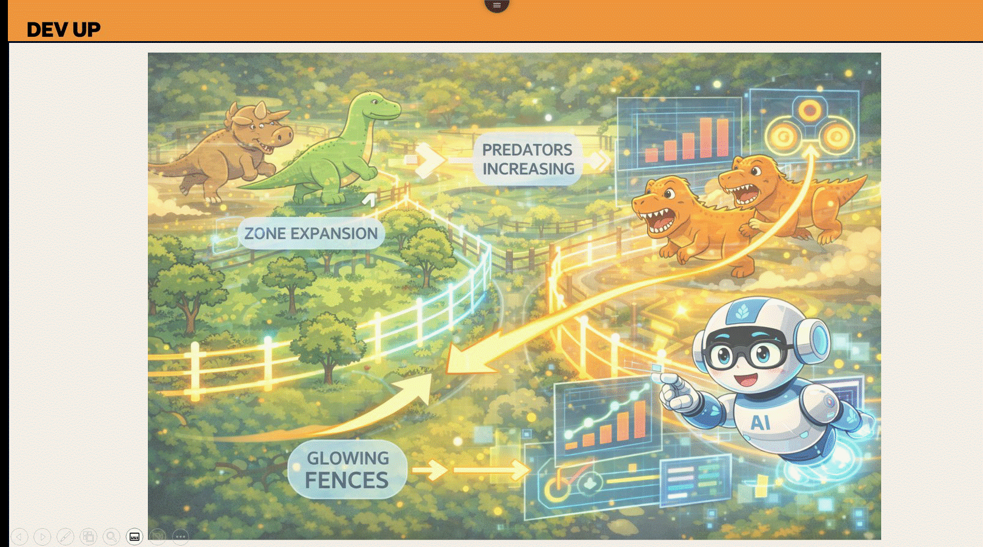
DEV UP

Slide 26
DEV UP
How It Works
From Strategy to Runtime & Back
OPTIMIZATION LOOP
01
02
03
Capture Intent
Generate Artefacts
Contextual Build
PMs define high-level goals and constraints. System captures "Why" before "What."
→
AI synthesizes Requirements, ADRs, and Boilerplate. Architecture is defined early.
→
Developers build with intent-aware context directly in the IDE. Zero ambiguity.
↓
06
05
04
Runtime Feedback
Evidence Gating
Derived Verification
Operational signals feed back into the graph, informing future planning cycles.
←
Release is unlocked only when evidence matches the definition of done.
←
CI runs validation against original intent, not just passing code tests.
ENGINEERING EXCELLENCE

Slide 27
DEV UP

Slide 28
DEV UP
Value Proposition: Product
High-Leverage Product Ownership
From "Juggling Inputs" to "Shaping Outcomes"
Consolidated Demand
Intelligent Sequencing
Dynamic Re-planning
A unified view of all cross-system requirements, eliminating the "spreadsheet shuffle" of tracking disjointed requests.
AI-assisted prioritization based on deep dependency maps, identifying critical paths before they become blockers.
Automatic impact analysis when business priorities shift. Instantly visualize the ripple effect of "just one small change."
✓ Single backlog of truth
✓ Dependency-aware ranking
✓ Instant impact analysis
✓ Cross-team visibility
✓ Bottleneck prediction
✓ Reality-based deadlines
The Net Effect
Higher confidence in roadmaps. Zero "surprise" dependencies. Better alignment with leadership.
ENGINEERING EXCELLENCE

Slide 29
DEV UP
Value Proposition: Delivery Leads
Predictable Delivery Management
From "Chasing Updates" to "Managing Flow"
Real-time Fidelity
Early-Warning Systems
Evidence-Based Health
Instant visibility into work-in-flight without manual status calls. See the reality of execution as it happens, not days later.
Risk signals triggered by design drift, not just missed dates. Intervene when the plan breaks, not when the deadline passes.
Status is derived from actual system evidence (PRs, Tests, Deploys), not narrative opinions. Trust the data, not the story.
✓ No manual status reports
✓ Drift alerts
✓ Data-driven status
✓ Live WIP tracking
✓ Proactive risk mitigation
✓ Objective reporting
The Net Effect
Elimination of "fire drills." Predictable delivery cycles. Reduced coordination overhead.
ENGINEERING EXCELLENCE

Slide 30
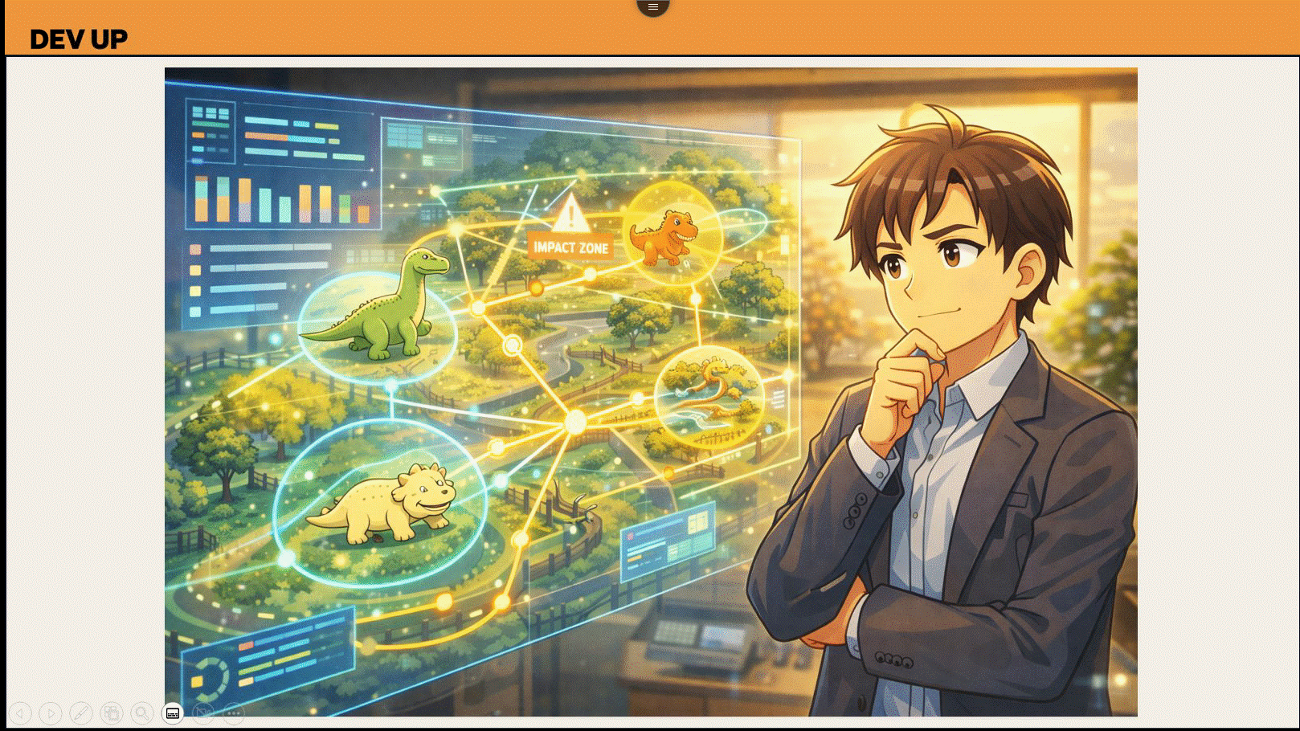
DEV UP

Slide 31
DEV UP
Every Zone

Slide 32
DEV UP
Value Proposition: Architecture
Architecture as a Living Guardrail
Ensuring Design Intent Survives Implementation
Generative Design
Drift Detection
Institutional Persistence
Architecture generated early from requirements. Transform abstract intent into concrete technical diagrams and specifications instantly.
Automatic alerts when code deviates from design rationale. Catch "quick hacks" that violate architectural standards before they merge.
Designs and decisions survive team attrition. Capture the "Why" behind every structural choice in a durable, queryable format.
✓ Auto-generated diagrams
✓ Design-Code compliance
✓ Durable decision logs
✓ Requirement-to-Spec
✓ Anti-pattern alerts
✓ Attrition-proof context
The Net Effect
Stronger consistency across the portfolio. Reduced re-explanation. Architecture becomes a facilitator, not a PDF.
ENGINEERING EXCELLENCE

Slide 33
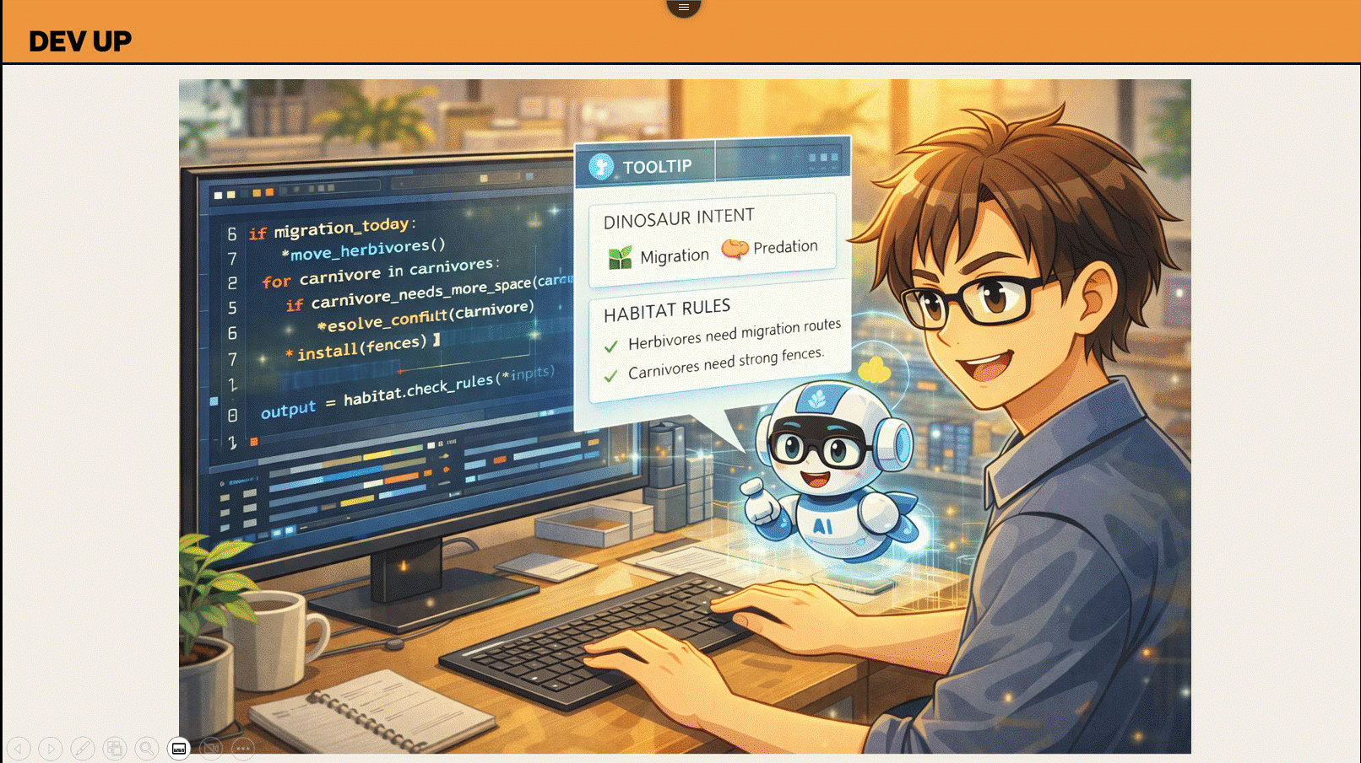
DEV UP

Slide 34
DEV UP
Value Proposition: Developers
Engineering Velocity & Focus
Building with Confidence, Not Guesswork
Automated Kickstarts
Context-at-Hand
Frictionless Clarity
Project scaffolding generated directly from intent. Skip the setup fatigue and start writing business logic immediately.
Requirements, constraints, and architecture decisions visible directly in the IDE. Stop alt-tabbing to find the "Why".
No more "waiting for clarification" loops. The system ensures definitions are complete before they reach your queue.
✓ Standardized patterns
✓ IDE Integration
✓ Zero wait states
✓ Security by default
✓ Design specs in-situ
✓ Self-service answers
The Net Effect
Faster onboarding. Cleaner implementations. Drastic reduction in "frustration rework."
ENGINEERING EXCELLENCE

Slide 35
DEV UP
Value Proposition: Reliability & Ops
Operational Integrity
Closing the Loop between Design and Runtime
Derived Testing
Readiness Evidence
Traceable RCA
Test scenarios generated directly from the "Why". Ensuring validation logic is never decoupled from the original business intent.
Automated proof of "Definition of Done" before deployment. Releases are gated by evidence, not just manual approvals.
Root-cause analysis that links runtime failures back to design decisions. Instantly identify the logic gap that caused the crash.
✓ Intent-based coverage
✓ Compliance as code
✓ Design-to-crash linkage
✓ Auto-generated scenarios
✓ Gate on evidence
✓ Faster resolution (MTTR)
The Net Effect
Higher release confidence. Faster incident resolution. Zero "blind" deployments.
ENGINEERING EXCELLENCE

Slide 36
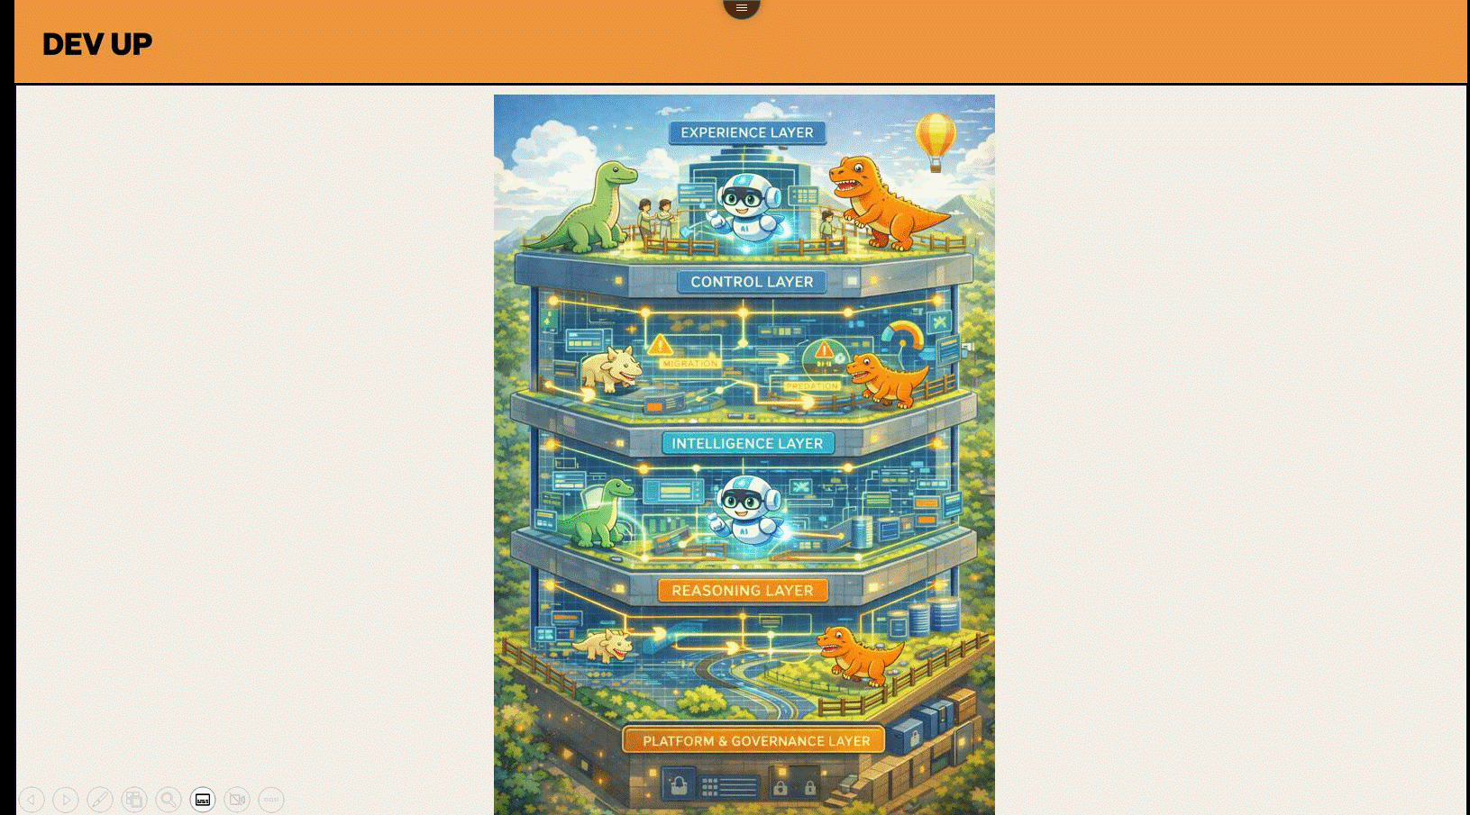
DEV UP

Slide 37
DEV UP
Technical Architecture
A Governed, Scalable Reasoning Layer
Experience Layer
System Flow
Chat UI, APIs, file upload, response rendering, etc.
1
Semantic Router & Context Window
Instead of just "Input," we analyze the intent. The system dynamically assembles context from the Graph (Code + JIRA + Docs) before the LLM is even invoked.
Control Layer
Agents (PO, Architect, Reviewer etc.), workflows, iteration limits & human-in-loop.
2
Multi-Agent Orchestration (The "Brain")
Intelligence Layer
Planner Agent: Breaks complex queries into sub-tasks. Execution Agent: Calls enterprise-grade foundation models. Critic Agent: Validates output against known constraints.
LLM & RL models that synthesize artefacts and reason over the delivery graph.
Knowledge/Action Layer
3
Enterprise Guardrails (The "Lock")
Graph store, retrieval & ranking, vector memory, domain APIs.
Pre-Guard: Permission enforcement. Post-Guard: Syntax validation and "Human-in-the-Loop" approval gates. Feedback Loop: Accepted actions fed back into Vector Memory.
Platform & Governance Layer
Security, reliability, data, infrastructure, observability & policy.
The Governance Lock
"Truth stays in the systems of record. Reasoning is governed by AI. Actions are always Human-Approved."
ENGINEERING EXCELLENCE

Slide 38
DEV UP
The Roadmap
Evolution of the System
From Foundation to Autonomous Intelligence
Phase 1: Connected Intelligence
CURRENT
Phase 2: Autonomous Engineering
VISION
Establishing a unified delivery graph and assisted workflows for all personas.
Transitioning from Assistant to Agent with proactive, autonomous capabilities.
Unified Delivery Graph
Agent-Driven Automation
Links Strategy to Code, providing a single source of truth for Directors, Architects, Product Owners, and Developers.
Background agents detect vulnerabilities, select optimal reasoning models, generate fixes, validate against governance, and prompt for human approval.
→
Dependency Awareness
Delegated Work Execution
Real-time visibility into system dependencies — know instantly if a change in 'System A' impacts 'System B.'
Focus shifts from finding information to delegating tasks — agents handle work, humans approve.
Enterprise-grade foundation models — model-agnostic by design.
Assisted Workflows
Live support for workflows, moving beyond simple Retrieval-Augmented Generation (RAG).
Works alongside whatever coding tools your teams already use.
Status
Status
Assisted workflows and dependency tracking are live and validated.
Learning from live assisted workflows; vision for full autonomy underway.
ENGINEERING EXCELLENCE

Slide 39
DEV UP
Measurable Impact
The ROI of Coherence
Phase 1 deployment benchmarks, validated against industry baselines
Reduction
Reduction
Qualitative Shift
25-35%
20-30%
LEADERSHIP
Rework Reduction
Coordination Cost
Reporting
→
Informing
Driven by earlier intent clarity and automated validation.
Fewer alignment meetings and manual status checks.
ENGINEERING
Faster
Faster
Reconstructing
→
Constructing
15-25%
40-70%
ORGANIZATION
Cycle Time Predictability
Onboarding Speed
Hero Culture
→
Memory
Reduced wait states via dependency transparency.
Instant context retrieval vs. relying on oral history.
"Coherence makes complexity compound in your favour."
ENGINEERING EXCELLENCE

Slide 40
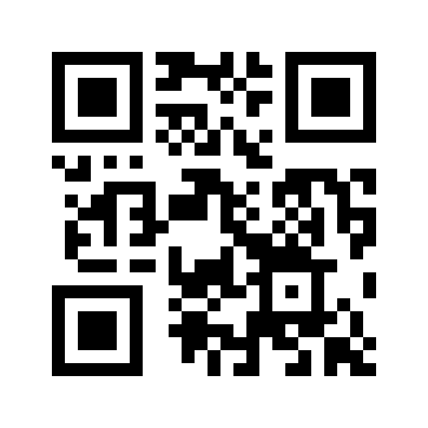
DEV UP
"The Park Is Open."
What's Your SDLC Age?
You'll also get:
2-minute self-assessment
✓ Architecture one-pager (PDF)
Jurassic
Industrial
Modern
Autonomous-Ready
✓ Link to request a pilot
Visit us at the booth — right after this session
Bring one use case. Ten minutes. See the difference.
Scan to take the assessment
"Let's stop paying the Scale Tax. Let's start architecting coherence."
ENGINEERING EXCELLENCE

Slide 41
AI Engineering in Banking — Quiz
DEV UP
DevUp 2026 · SmartSDLC
Q1:
Same prompt, same code, two GPT-4 answers
Q5:
AI agent via bank APIs: who owns the change?
Non-determinism — model risk
Nobody — no ownership
Q2:
Attacker hides text in docs. What attack?
Q6:
#1 barrier to AI adoption at scale?
Prompt injection via docs
Lacks system context
Q3:
Fix passes tests. Production incident 3mo later?
Q7:
LLM generates docs for COBOL. Core risk?
Violated undocumented contract
Hallucinate rules
Q4:
Fraud ML: recall drops 18%, no code change?
Q8:
AI writes code and tests, all pass?
Model drift
Business intent & regs
Scan QR → Take the quiz → Get your AI Banking Scorecard

Slide 42
QUESTIONS?

